Slide 1
Social buzz analysis
Moses Fernandes

Slide 2

Agenda
Project Summary
Problem
Analytics Team
Process
Insights
Recommendations

Slide 3

Project Summary
Social Buzz is a social media conglomerate which emphasizes content by keeping all users anonymous, only tracking user reactions on every piece of content.
Accenture is running a 3 month initial project and is tasked the following:
- An audit of their big data practice.
- Recommendations for a successful IPO.
- An analysis of their content categories that highlights the top 5 categories with the largest aggregate popularity.

Slide 4

Problem
The problem being faced by Social Buzz is the challenge of effectively managing and analysing the massive amount of unstructured data generated from their rapidly growing user base.
The company needs to find a solution to efficiently handle and maintain this complex technology infrastructure.

Slide 5



ANALYTICS Team
ANDREW FLEMING
MARCUS ROMPTON
MOSES FERNANDES
CHIEF TECHNICAL ARCHITECT
SENIOR PRINCIPLE
DATA ANALYST

Slide 6
process
Understanding the data model
Data Cleaning
Merging Data
Analyse Data
Share Findings

Slide 7
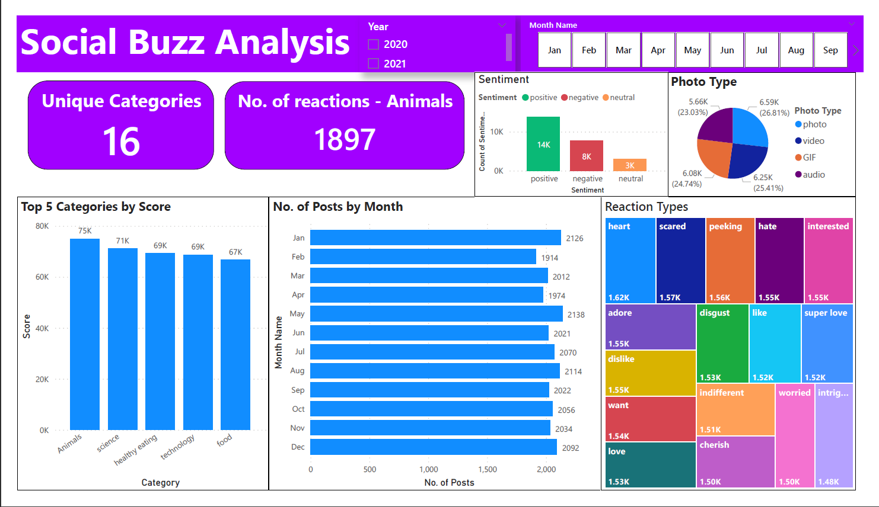
Insights

Slide 8

Findings
There are about 16 unique categories
Animals occupy the highest scoring category with 1,897 reactions.
May has the highest number of posts while February has the least number of posts.
A positive sentiment is expressed by 14,000 individuals and a negative sentiment is expressed by 8,000 individuals
There are 4 content types – Photos , Videos , GIFs and Audio. The most frequently posted content type is photos with 6.59k posts.

Slide 9
Recommendations
Continue producing more content on animals since it is the most scored category. This can help increase user engagement.
It is essential to identify the underlying factors contributing to positive, negative and neutral sentiment. Understand what drives positive sentiment and what triggers negative sentiment
Although photos are the predominant content type, there is a balanced production of videos, GIFs, and audio. To cater to varied user preferences and enhance the user experience, diversifying the content mix by increasing the production of videos, GIFs, and audio content will provide a broader range of content options and contribute to a more engaging and enriching experience for the users.
Conduct a detailed analysis as to why May is the month with maximum engagement. Various factors such as seasonal trends , cultural events and app updates could be some contributing factors.
Consider establishing partnerships with various companies in the animal , science and health industries as these collaborations can raise awareness as well as boost engagement.

Slide 10
THANK YOU

